Slide 1
Chapter 11
Distributed Systems Architectures

Slide 2
Review
What is software architecture?
What is software framework?
What are differences between architecture and framework?

Slide 3
Architecture and framework
They are distinct
Architecture is a kind of thinking, system blueprint, which determines subsystems and its interfaces etc. such as MVC, J2EE
Framework is a semi-realization of a architecture, such as JSF, Struts

Slide 4
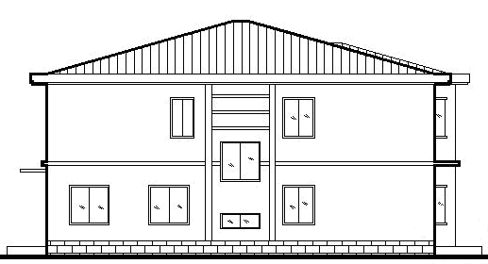
When use architecture and framework?
9简单需求
Simple Requirements

Slide 5
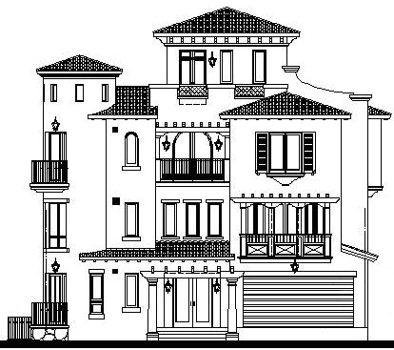
Complex requirements

Slide 6
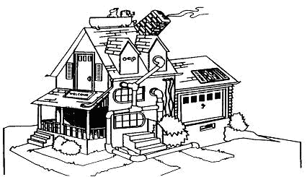
No architecture case

Slide 7
When use framework?
I strongly suggest each system should make use of Framework to reduce effort, error, and many other benefits.

Slide 8
Objectives
To explain the advantages and disadvantages of different distributed systems architectures
To discuss client-server and distributed object architectures
To describe object request brokers and the principles underlying the CORBA standards
To introduce peer-to-peer and service-oriented architectures as new models of distributed computing.

Slide 9
Topics covered
Multiprocessor architectures
Client-server architectures
Distributed object architectures
Inter-organisational computing

Slide 10
Distributed systems
Virtually all large computer-based systems are now distributed systems.
Information processing is distributed over several computers rather than confined to a single machine.
Distributed software engineering is therefore very important for enterprise computing systems.

Slide 11
System types
Personal systems that are not distributed and that are designed to run on a personal computer or workstation.
Embedded systems that run on a single processor or on an integrated group of processors.
Distributed systems where the system software runs on a loosely integrated group of cooperating processors linked by a network.

Slide 12
Distributed system characteristics
Resource sharing
  Sharing of hardware and software resources.
Openness
  Use of equipment and software from different vendors.
Concurrency
  Concurrent processing to enhance performance.
Scalability
  Increased throughput by adding new resources.
Fault tolerance
  The ability to continue in operation after a fault has occurred.

Slide 13
Distributed system disadvantages
Complexity
  Typically, distributed systems are more complex than centralised systems.
Security
  More susceptible to external attack.
Manageability
  More effort required for system management.
Unpredictability
  Unpredictable responses depending on the system organisation and network load.

Slide 14
Distributed systems architectures
Client-server architectures
  Distributed services which are called on by clients. Servers that provide services are treated differently from clients that use services.
Distributed object architectures
  No distinction between clients and servers. Any object on the system may provide and use services from other objects.

Slide 15
Middleware
Software that manages and supports the different components of a distributed system. In essence, it sits in the middle of the system.
Examples
  Transaction processing monitors;
  Data converters;
  Communication controllers.

Slide 16
Multiprocessor architectures
Simplest distributed system model.
System composed of multiple processes which may (but need not) execute on different processors.
Architectural model of many large real-time systems.

Slide 17
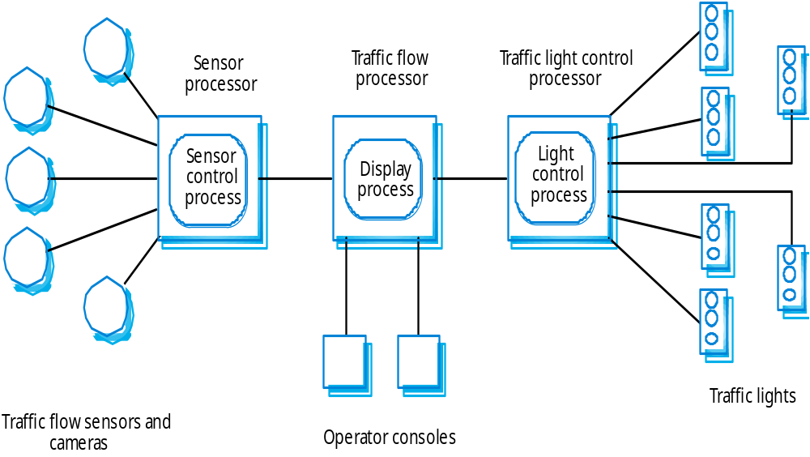
A multiprocessor traffic control system

Slide 18
Client-server architectures
The application is modelled as a set of services that are provided by servers and a set of clients that use these services.
Clients know of servers but servers need not know of clients.
Clients and servers are logical processes

Slide 19
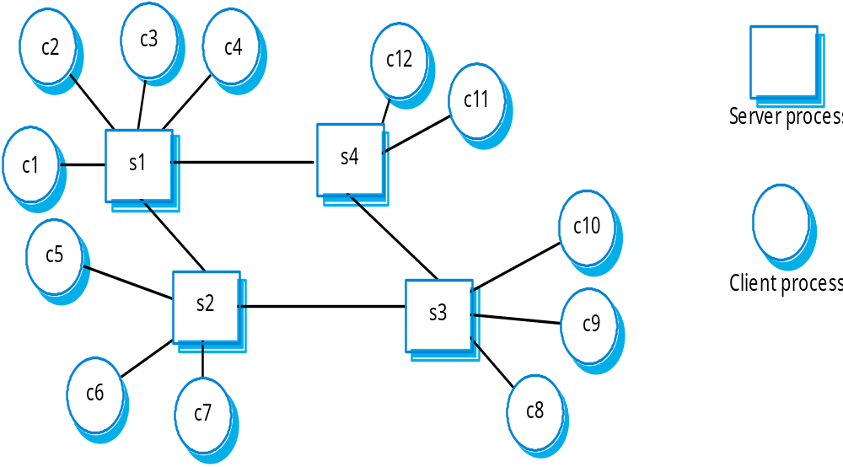
A client-server system

Slide 20
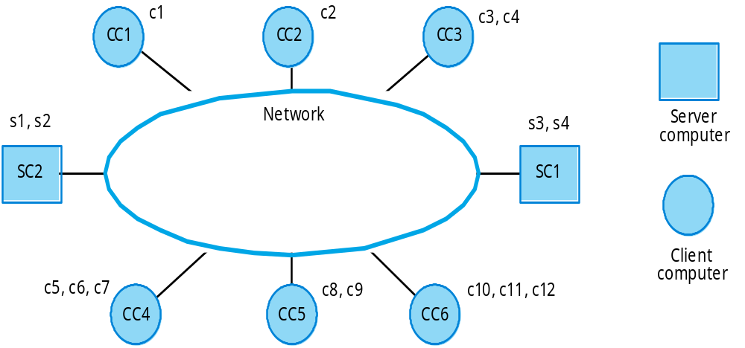
Computers in a C/S network

Slide 21
Layered application architecture
Presentation layer
  Concerned with presenting the results of a computation to system users and with collecting user inputs.
Application processing layer
  Concerned with providing application specific functionality e.g., in a banking system, banking functions such as open account, close account, etc.
Data management layer
  Concerned with managing the system databases.

Slide 22
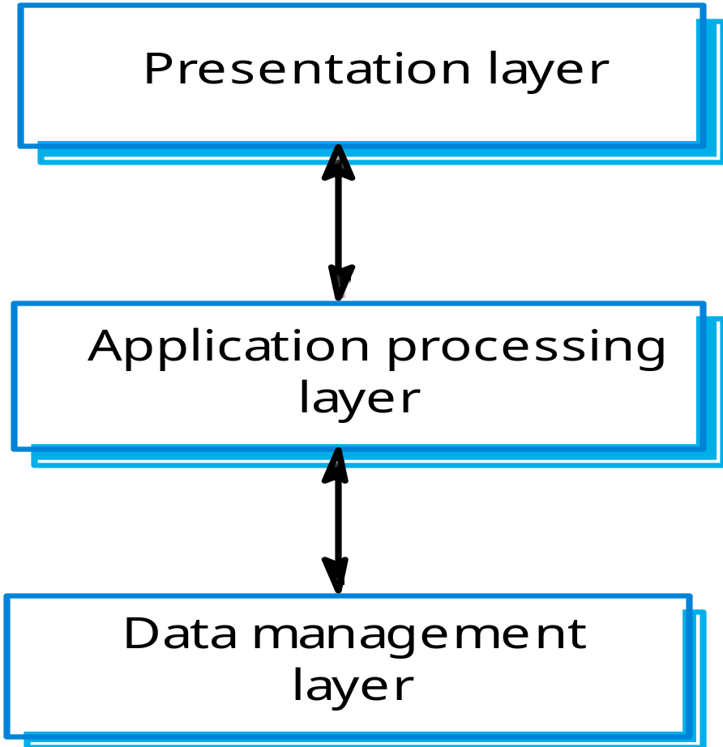
Application layers

Slide 23
Thin and fat clients
Thin-client model
  In a thin-client model, all of the application processing and data management is carried out on the server. The client is simply responsible for running the presentation software.
Fat-client model
  In this model, the server is only responsible for data management. The software on the client implements the application logic and the interactions with the system user.

Slide 24
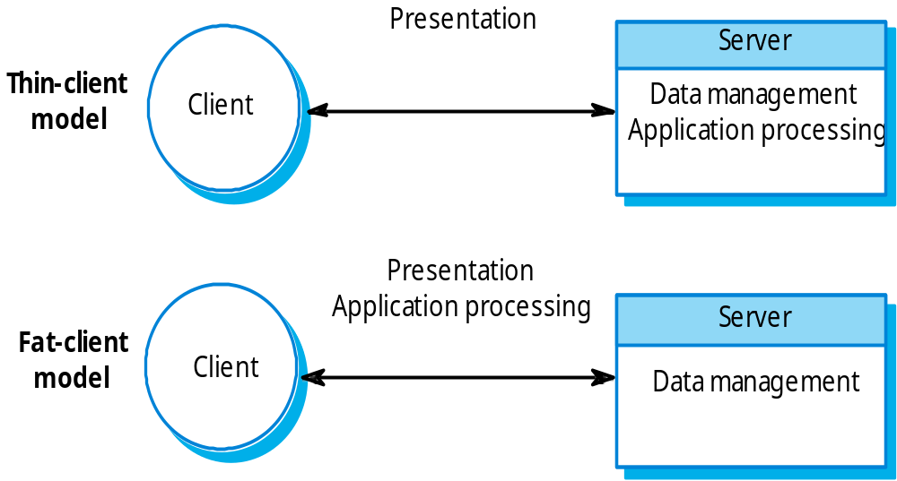
Thin and fat clients

Slide 25
Thin client model
Used when legacy systems are migrated to client server architectures.
  The legacy system acts as a server in its own right with a graphical interface implemented on a client.
A major disadvantage is that it places a heavy processing load on both the server and the network.

Slide 26
Fat client model
More processing is delegated to the client as the application processing is locally executed.
Most suitable for new C/S systems where the capabilities of the client system are known in advance.
More complex than a thin client model especially for management. New versions of the application have to be installed on all clients.

Slide 27
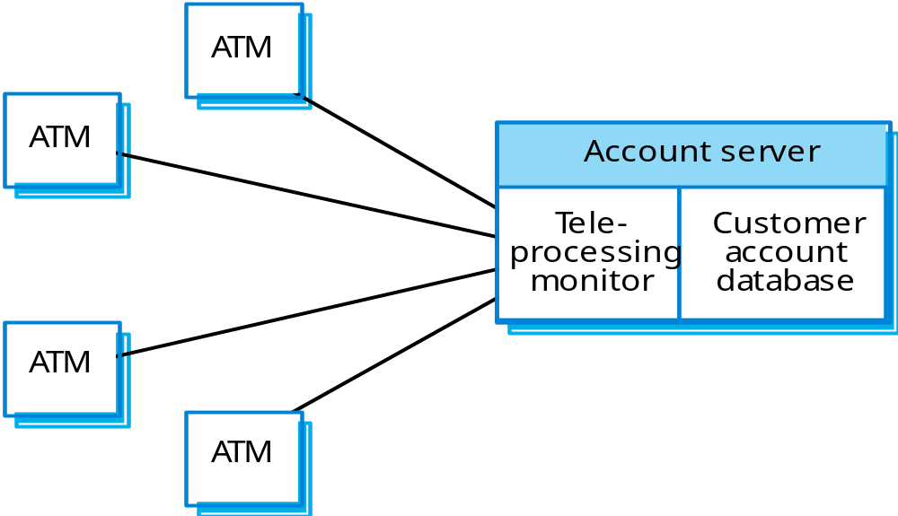
A client-server ATM system

Slide 28
Three-tier architectures
In a three-tier architecture, each of the application architecture layers may execute on a separate processor.
Allows for better performance than a thin-client approach and is simpler to manage than a fat-client approach.
A more scalable architecture - as demands increase, extra servers can be added.

Slide 29
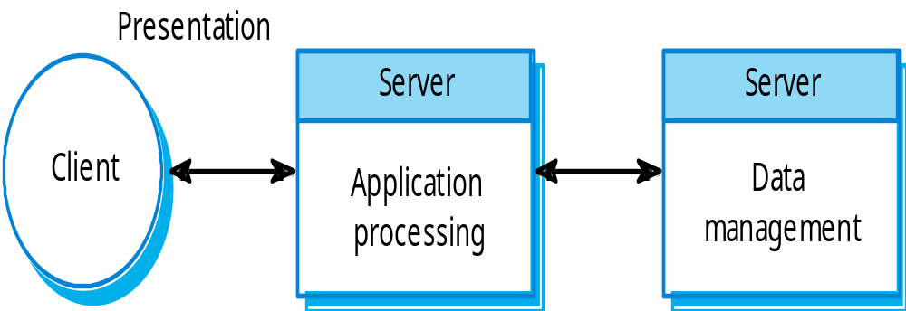
A 3-tier C/S architecture

Slide 30
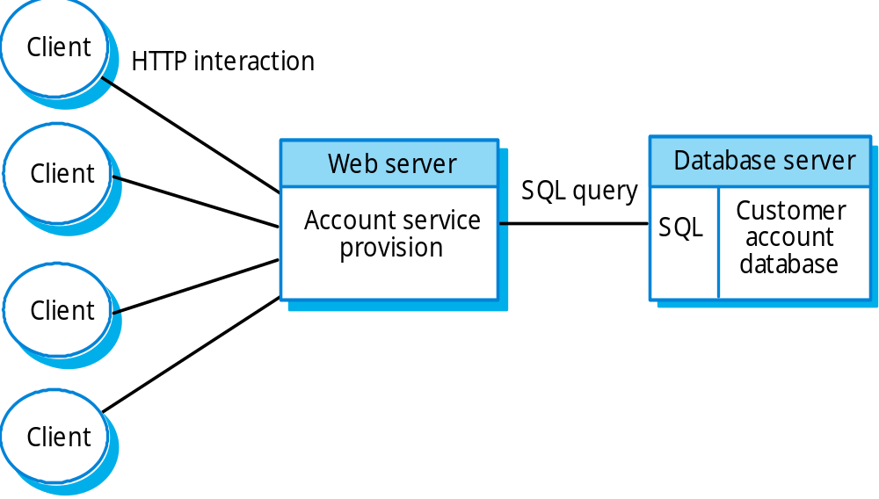
An internet banking system

Slide 31
Review
What is C/S architecture?
What is thin client, fat client C/S architecture? Advantage and disadvantage?
Library system’s client decision?

Slide 32
Distributed object architectures
There is no distinction in a distributed object architectures between clients and servers.
Each distributable entity is an object that provides services to other objects and receives services from other objects.
Object communication is through a middleware system called an ORB (object request broker).
However, distributed object architectures are more complex to design than C/S systems.

Slide 33
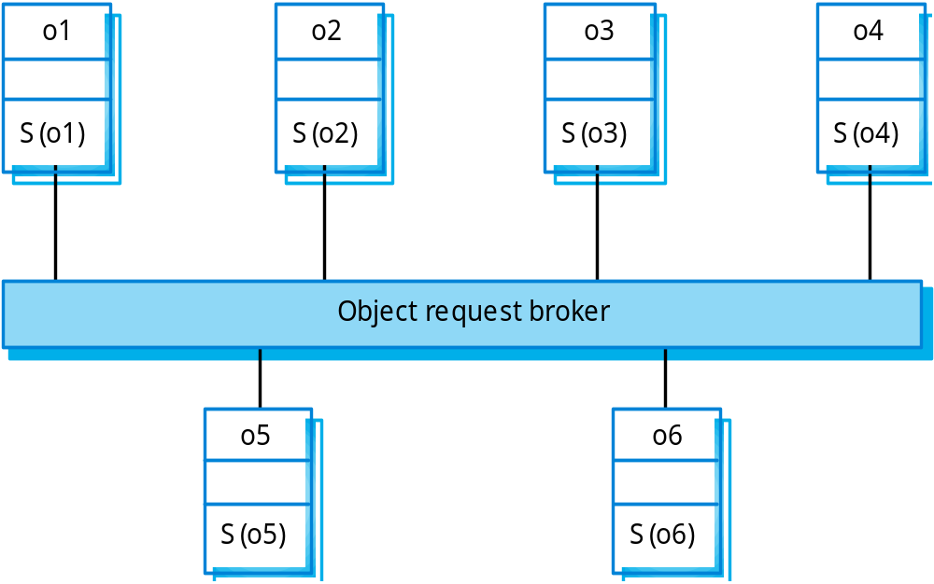
Distributed object architecture

Slide 34
Advantages of distributed object architecture
It allows the system designer to delay decisions on where and how services should be provided.
It is a very open system architecture that allows new resources to be added to it as required.
The system is flexible and scaleable.
It is possible to reconfigure the system dynamically with objects migrating across the network as required.

Slide 35
CORBA
CORBA is an international standard for an Object Request Broker - middleware to manage communications between distributed objects.
Middleware for distributed computing is required at 2 levels:
  At the logical communication level, the middleware allows objects on different computers to exchange data and control information;
  At the component level, the middleware provides a basis for developing compatible components. CORBA component standards have been defined.

Slide 36
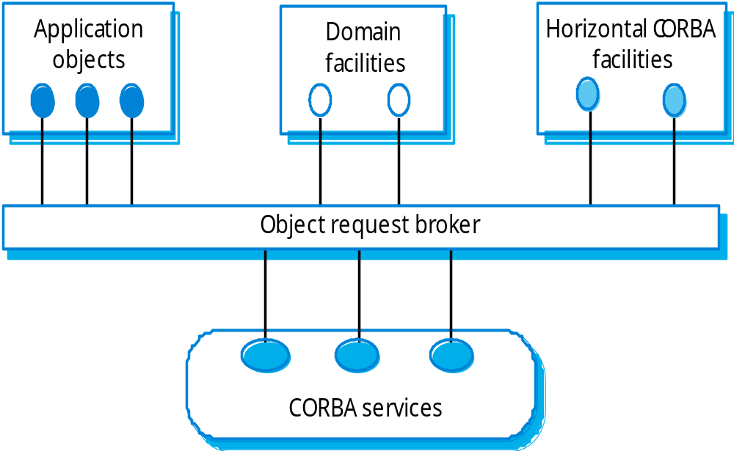
CORBA application structure

Slide 37
Application structure
Application objects.
Standard objects, defined by the OMG, for a specific domain e.g. insurance.
Fundamental CORBA services such as directories and security management.
Horizontal (i.e. cutting across applications) facilities such as user interface facilities.

Slide 38
CORBA standards
An object model for application objects
  A CORBA object is an encapsulation of state with a well-defined, language-neutral interface defined in an IDL (interface definition language).
An object request broker that manages requests for object services.
A set of general object services of use to many distributed applications.
A set of common components built on top of these services.

Slide 39
CORBA objects
CORBA objects are comparable, in principle, to objects in C++ and Java.
They MUST have a separate interface definition that is expressed using a common language (IDL) similar to C++.
There is a mapping from this IDL to programming languages (C++, Java, etc.).
Therefore, objects written in different languages can communicate with each other.

Slide 40
Object request broker (ORB)
The ORB handles object communications. It knows of all objects in the system and their interfaces.
Using an ORB, the calling object binds an IDL stub that defines the interface of the called object.
Calling this stub results in calls to the ORB which then calls the required object through a published IDL skeleton that links the interface to the service implementation.

Slide 41
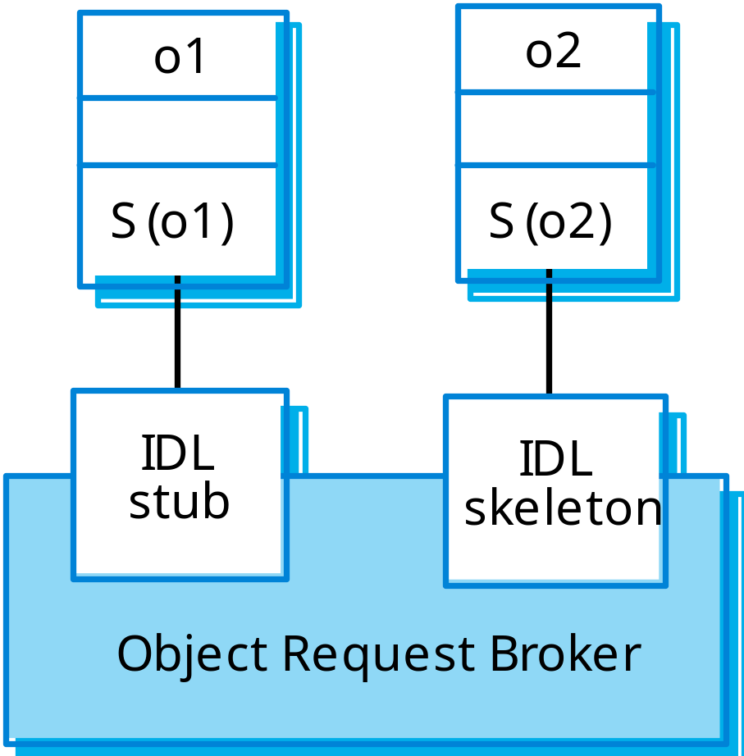
ORB-based object communications

Slide 42
Inter-ORB communications
ORBs are not usually separate programs but are a set of objects in a library that are linked with an application when it is developed.
ORBs handle communications between objects executing on the sane machine.
Several ORBS may be available and each computer in a distributed system will have its own ORB.
Inter-ORB communications are used for distributed object calls.

Slide 43
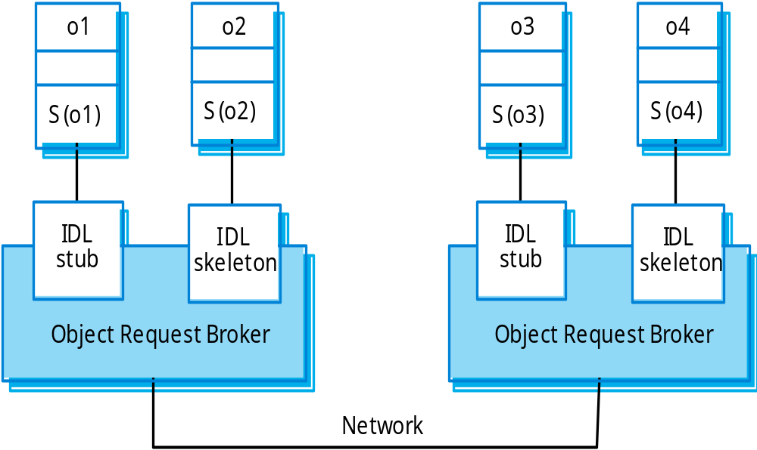
Inter-ORB communications

Slide 44
CORBA services
Naming and trading services
  These allow objects to discover and refer to other objects on the network.
Notification services
  These allow objects to notify other objects that an event has occurred.
Transaction services
  These support atomic transactions and rollback on failure.

Slide 45
Inter-organisational computing
For security and inter-operability reasons, most distributed computing has been implemented at the enterprise level.
Local standards, management and operational processes apply.
Newer models of distributed computing have been designed to support inter-organisational computing where different nodes are located in different organisations.

Slide 46
Peer-to-peer architectures
Peer to peer (p2p) systems are decentralised systems where computations may be carried out by any node in the network.
The overall system is designed to take advantage of the computational power and storage of a large number of networked computers.
Most p2p systems have been personal systems but there is increasing business use of this technology.

Slide 47
P2p architectural models
The logical network architecture
  Decentralised architectures;
  Semi-centralised architectures.

Slide 48
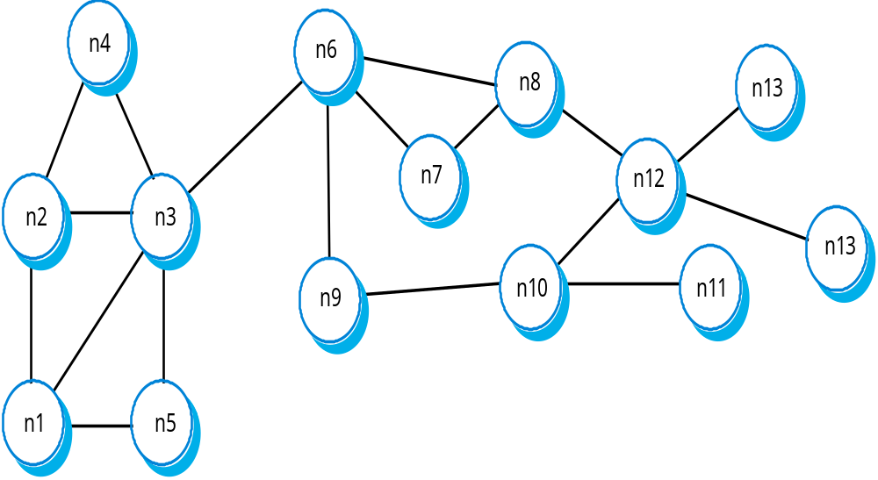
Decentralised p2p architecture

Slide 49
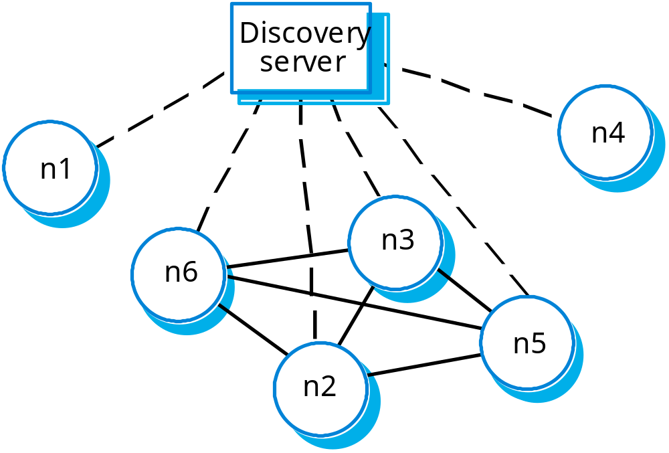
Semi-centralised p2p architecture

Slide 50
Key points
Distributed systems support resource sharing, openness, concurrency, scalability, fault tolerance and transparency.
Client-server architectures involve services being delivered by servers to programs operating on clients.
User interface software always runs on the client and data management on the server. Application functionality may be on the client or the server.
In a distributed object architecture, there is no distinction between clients and servers.

Slide 51
Key points
Distributed object systems require middleware to handle object communications and to add and remove system objects.
The CORBA standards are a set of middleware standards that support distributed object architectures.
Peer to peer architectures are decentralised architectures where there is no distinction between clients and servers.

